Slide 1
Movie Recommendation System Using Cosine Similarity
A project by:
Neelay Jagani 1814024
Jai Mehta 1814036
Pankti Nanavati 1814045
Jash Shah 1814054

Slide 2
INTRODUCTION
In today’s world Recommendation systems have gained immense popularity allowing people to make right choices without having in-depth knowledge about the things that people are dealing with.
We have been using applications like Amazon, Netflix, Hotstar etc… which give us recommendations.
Recommendation Systems are built using algorithms that go through various preferences of an individual and create a personalised list based on a number of factors like profile, browsing history, product ratings etc…
We have built a movie recommendation system that uses cosine similarity as a metric to find the similarity between the movies a user searches for and recommends movies to the user based on the keywords, cast, genre and directors of the entered movie.

Slide 3
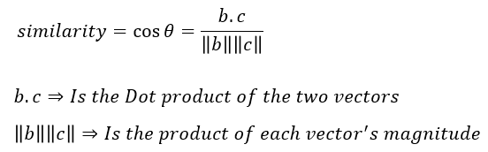
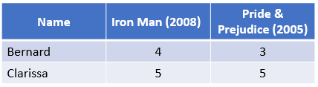

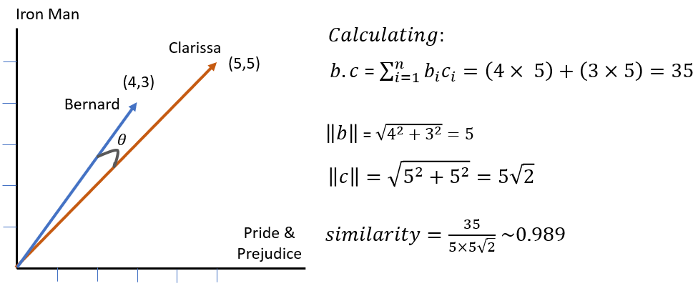
APPLICATION OF SIMILARITY MEASURES
Movie Recommendation System
We get the similarity measure as 0.989 which is very close to 1. This implies that the two movie reviewers i.e Bernard and Clarissa have almost similar movie preferences.

Slide 4
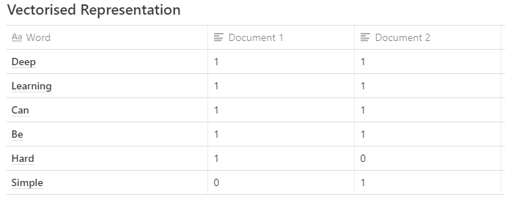
2. Document Similarity
Documents can be checked for similarity by converting the words/sentences/phrases in each document into vectors. Then, these vectors are substituted in the cosine similarity formula to get the cosine similarity value.
EXAMPLE:
Document 1- Deep Learning can be hard
Document 2- Deep Learning can be simple
Step 1:
A = [1, 1, 1, 1, 1, 0]; B = [1, 1, 1, 1, 0, 1]

Slide 5
Contd..
Step 2:
Finding the cosine similarity
cosine similarity (CS) = (A . B) / (||A|| ||B||)
The dot product between A and B: 1.1 + 1.1 + 1.1 + 1.1 + 1.0 + 0.1 = 4
The magnitude of the vector A: √1.0² + 1.0² + 1.0² + 1.0² + 1.0² + 0.0² = 2.2360
The magnitude of the vector B: √1.0² + 1.0² + 1.0² + 1.0² + 0.0²+ 1.0² = 2.2360
The cosine similarity: (4) / (2.2360679775*2.2360679775) = 0.80
Therefore, there is 80% similarity between the sentences in both document

Slide 6
3. Pose Matching
In Pose Matching key points of joint locations in one image is compared to key points from another image.
Thus, pose matching is done by comparison of key points.
Deriving the position or orientation of the body parts and joints from an image or series of images is known as pose estimation.
EXAMPLE:
To measure the similarity between two poses in Image A and Image B. Steps for the process are mentioned below:
Step 1: Initially, identify the pose information and derive the location key points(joints) in Image A

Slide 7
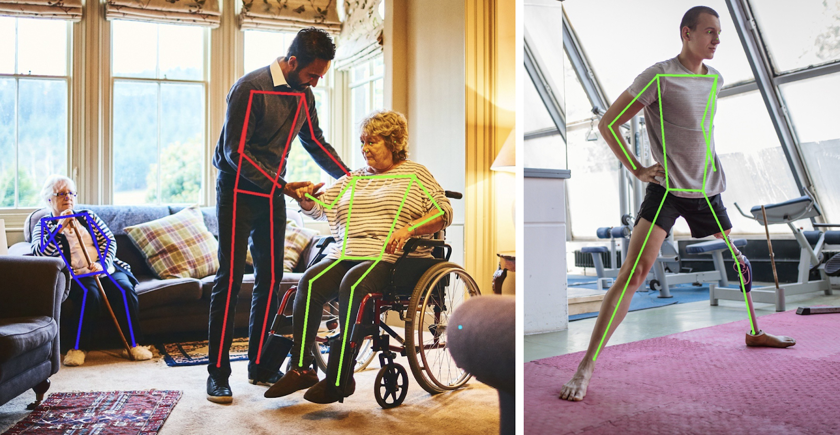
Contd.
Step 2: Identify the x,y location of all the respective joints required for comparison. Deep Learning solution to pose estimation usually provides information on the location of the joints within a particular pose, along with an estimation confidence score.
Step 3: Repeat above two steps for Image B
Step 4: Form a vector containing all x,y positions of Image A
Step 5: Form a vector containing all x,y positions of Image B
Step 6: Both vectors should have the same order of x,y positions of each joint
Step 7: Perform cosine similarity using both vectors to obtain a number between 0 and 1

Slide 8
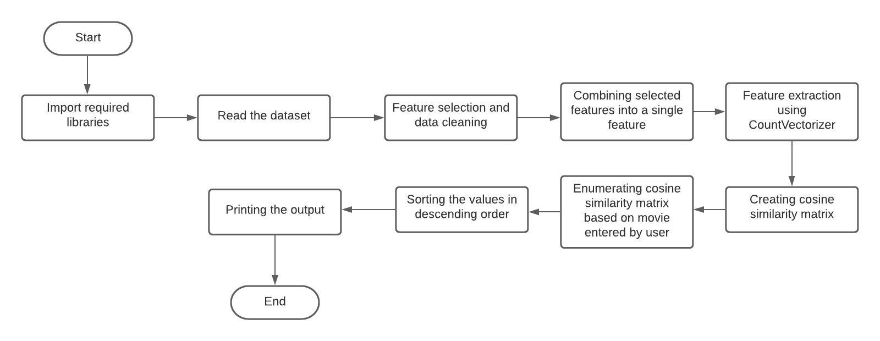
METHODOLOGY

Slide 9
TOOLS AND LIBRARIES
Libraries
scikit-learn 0.24.2
sklearn.feature_extraction.text.CountVectorizer
sklearn.metrics.pairwise.cosine_similarity
Tools
Google Colaboratory
Dataset
Link to Dataset

Slide 10
DEMONSTRATION
Link to the notebook

Slide 11
RESULTS AND DISCUSSION
The implementation of Movie Recommendation System is able to generate five similar movies, these similarities we are checking with respect to genre, cast, keyword and director. Mathematically, if we are checking for similarities, two things are said to be similar if the angle between them is zilch, and are said completely independent with no similarity when the angle is approaching 90 degrees.
Traversing through the entire dataset and finding similarity, we are generating all movies with highest similarity or the lowest angle between entities. The top five movies with highest similarity are displayed to the user as a recommendation.

Slide 12
REFERENCES
[1] Singh, Ramni & Maurya, Sargam & Tripathi, Tanisha & Narula, Tushar & Srivastav, Gaurav. (2020). Movie Recommendation System using Cosine Similarity and KNN. 2249-8958. 10.35940/ijeat.E9666.069520.
[2] I. Survyana Wahyudi, A. Affandi and M. Hariadi, "Recommender engine using cosine similarity based on alternating least square-weight regularization," 2017 15th International Conference on Quality in Research (QiR) : International Symposium on Electrical and Computer Engineering, 2017, pp. 256-261, doi: 10.1109/QIR.2017.8168492.
[3] Vijay Kotu, Bala Deshpande,Chapter 4 - Classification,Editor(s): Vijay Kotu, Bala Deshpande,Data Science (Second Edition),Morgan Kaufmann,2019,Pages 65-163,ISBN 9780128147610, https://doi.org/10.1016/B978-0-12-814761-0.00004-6.
[4] Rahutomo, Faisal & Kitasuka, Teruaki & Aritsugi, Masayoshi. (2012). Semantic Cosine Similarity.

Slide 13
[5] Gunawan, Dani & Sembiring, C & Budiman, Mohammad. (2018). The Implementation of Cosine Similarity to Calculate Text Relevance between Two Documents. Journal of Physics: Conference Series. 978. 012120. 10.1088/1742-6596/978/1/012120.
[6] A. R. Lahitani, A. E. Permanasari and N. A. Setiawan, "Cosine similarity to determine similarity measure: Study case in online essay assessment," 2016 4th International Conference on Cyber and IT Service Management, 2016, pp. 1-6, doi: 10.1109/CITSM.2016.7577578.
[7] https://towardsdatascience.com/using-cosine-similarity-to-build-a-movie-recommendation-system-ae7f20842599
[8] https://towardsdatascience.com/understanding-cosine-similarity-and-its-application-fd42f585296a
[9] https://www.analyticsvidhya.com/blog/2020/11/create-your-own-movie-movie-recommendation-system/

Slide 14
THANK YOU!

